Slide 1



Solar magnetic fields:
diagnostics and applications
^{A. Asensio Ramos}
Instituto de Astrofísica de Canarias
aasensio.github.io/blog
@aasensior
github.com/aasensio

Slide 2
Solar magnetic fields:
diagnostics and applications
Lecture 5
Scattering polarization and the Hanle effect
The classical view
Regimes
The quantum approach
Atomic polarization
The two-level atom
Some observations
Hazel
Applications

Slide 3
Polarización en líneas atómicas
Uno de los fenómenos más importantes en la física de la polarización tiene que ver con la dispersión de la radiación en electrones libres (Thomson/Compton) o en electrones ligados (atómos y moléculas).
Las propiedades de polarización de la radiación son distintas dependiendo del mecanismo que la genere y de la línea espectral en cuestión (de sus propiedades cuánticas).
En este capítulo estudiaremos los dos mecanismos principales que GENERAN polarización en líneas espectrales:
Efecto Zeeman
En este caso, la rotura de la simetría es debida a un campo magnético
2. Scattering resonante / polarización por impacto
En estos dos casos, la rotura de la simetría es debida a radiación / partículas con
una distribución anisótropa, respectivamente.

Slide 4
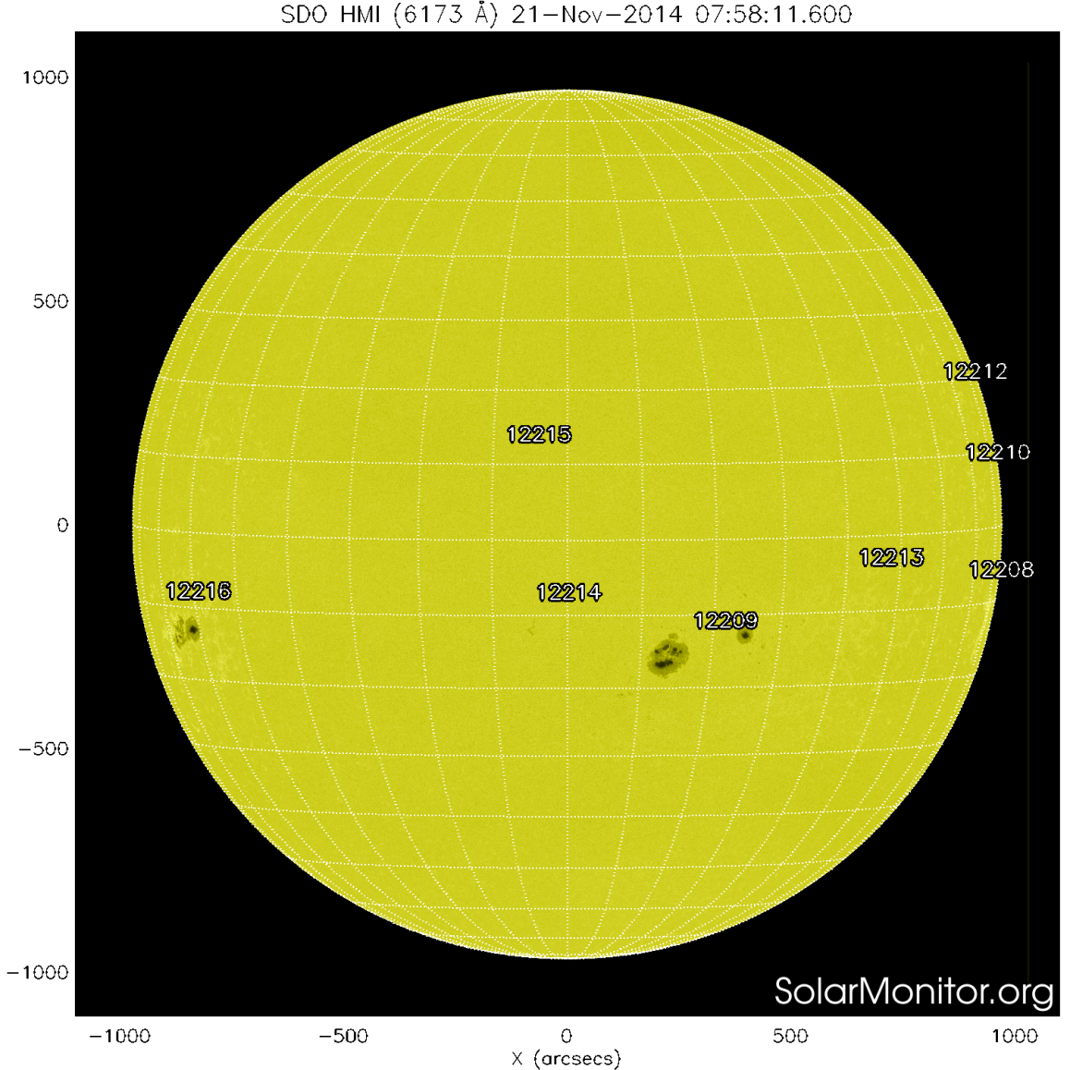
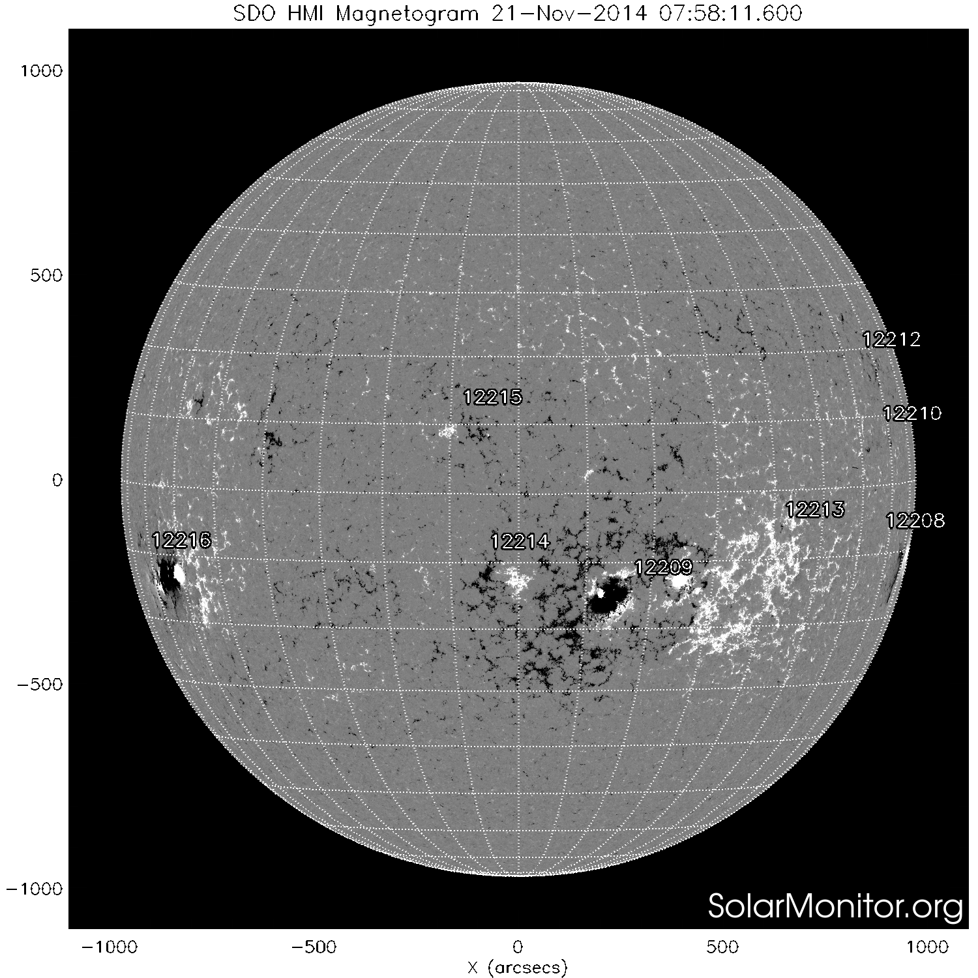
Polarization in spectral lines
Zeeman effect. Circularly polarized
light: magnetogram
Line-of-sight projection of B
Black/white: opposite polarities
Visible continuum
(solar surface)

Slide 5
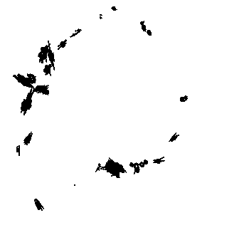
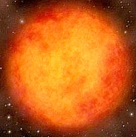
Scattering polarization in spectral lines
Scattering polarization
SiO maser
Typically tangential, but some
are radial because of local
variations of the anisotropy or
the presence of a magnetic
field

Slide 6
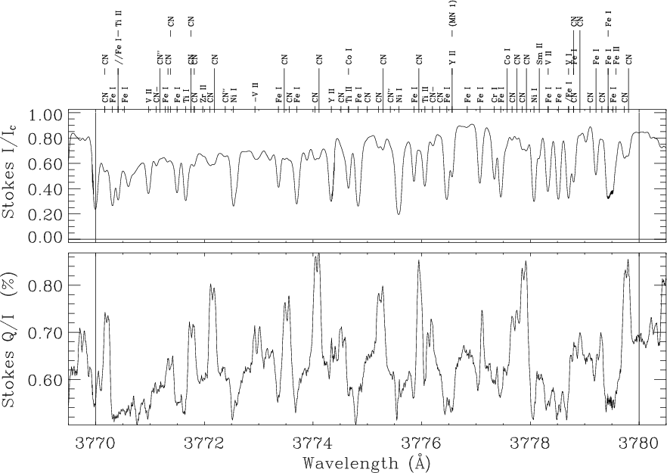
Scattering polarization in spectral lines
The second solar spectrum

Slide 7
Scattering polarization – Classical interpretation
z
Atom as 3 damped
linear oscillators
y
Non-polarized
incident light
Scattered light – linearly polarized
x
The light excites the z and x oscillators. They de-excite as a damped process
(with a lifetime of 1/A) and emit radiation. We only observe the z component

Slide 8
Scattering polarization – Change of basis
z
y
Non-polarized
incident light
Scattered light – linearly polarized
x
The change of basis leaves everything unchanged → there must exist
a phase relation between the two circular (equally excited) oscillators so
that the result is that the electron oscillates in the z axis

Slide 9
Hanle effect – Change of basis
z
y
Non-polarized
incident light
B
x
The presence of a magnetic field dephases the two circular oscillators
and the resulting linear polarization rotates and, typically, also
decreases

Slide 10
Hanle effect – Rotation of polarization
z
y
Non-polarized
incident light
B
x

Slide 11
Hanle effect – Increasing magnetic field
z
y
Non-polarized
incident light
B
x

Slide 12
Hanle effect – Very large magnetic field
z
y
Non-polarized
incident light
B
x

Slide 13
Hanle + Zeeman effects – Regimes
Very weak field
Hanle
Saturated Hanle
Weak-field Zeeman
Strong-field Zeeman
B
Very weak field regime: υ_{L}<< A_{ul}
The magnetic field is so weak that it does affect the splitting of the
components or the scattering polarization (compatible with zero field)

Slide 14
Hanle + Zeeman effects – Regimes
Very weak field
Hanle
Saturated Hanle
Weak-field Zeeman
Strong-field Zeeman
B
Hanle regime: υ_{L}~ A_{ul}, splitting smaller than the line width
The magnetic field is strong enough to reduce the phase correlations between
the oscillators. However, it is still small to produce a significant splitting

Slide 15
Hanle + Zeeman effects – Regimes
Very weak field
Hanle
Saturated Hanle
Weak-field Zeeman
Strong-field Zeeman
B
Saturated Hanle regime: υ_{L}>> A_{ul}, splitting of the order of line width
The magnetic field is strong enough to remove coherences and the oscillators
can be assumed to be independent. The splitting starts to be measurable

Slide 16
Hanle + Zeeman effects – Regimes
Very weak field
Hanle
Saturated Hanle
Weak-field Zeeman
Strong-field Zeeman
B
Weak-field Zeeman regime: υ_{L}>> A_{ul}, splitting of the order of line width
The magnetic field is strong enough to produce strong polarization signals
due to the splitting. However, the Zeeman components are still unresolved

Slide 17
Hanle + Zeeman effects – Regimes
Very weak field
Hanle
Saturated Hanle
Weak-field Zeeman
Strong-field Zeeman
B
Strong-field Zeeman regime: υ_{L}>> A_{ul}, splitting larger than the line width
The magnetic field is strong enough to produce strong polarization signals
due to the splitting. The Zeeman components are resolved

Slide 18
I
Q
U
V
No B
(scattering)
Hanle
Hanle
saturation
Weak
Zeeman
Strong
Zeeman

Slide 19
The quantum approach
B = 0
B ≠ 0
J’
M’
absorption
emission
J
M
Degenerate sublevels
M = -J, .., J

Slide 20
The quantum approach – Selection rules
J’
M’
J
M
Electric dipole/magnetic dipole
ΔJ = 0, ±1 except 0 → 0
ΔM = 0, ±1
ΔM = 0 → π component, linearly polarized
ΔM = ±1 → σ components, circularly polarized

Slide 21
The quantum approach – Sublevel population
J’
M’
J
M
Under isotropic illumination, each degenerate magnetic sublevel
has a population that is just proportional to its statistical weight

Slide 22
The quantum approach – Zeeman effect
M=1
M=0
J = 1
M=-1
σ⁺
π
σ⁻
λ
The amplitude is
proportional to the sublevel
population
J = 0
M=0
2 ways of emitting polarized radiation
Magnetic field → breaks the degeneration in the magnetic sublevels by an energy displacement
For instance, V = σ⁺ – σ⁻ = 0
unless they are displaced in energy (or wavelength)

Slide 23
The quantum approach – Atomic polarization
M=1
M=0
J = 1
M=-1
σ⁺
π
σ⁻
λ
The amplitude is
proportional to the sublevel
population
J = 0
M=0
2 ways of emitting polarized radiation
Magnetic field → breaks the degeneration in the magnetic sublevels by an energy displacement
Atomic polarization → different population in the magnetic sublevels
e.g. V = σ⁺ - σ⁻ ≠ 0 even without energy displacement

Slide 24
Statistical equilibrium equations
s
T_{E}
T_{S}
R_{A}
x
T_{A}
R_{E}
R_{S}
i
T_{A} : absorption rate
T_{E,S} : spontaneous/stimulated emission rate
R_{A} : relaxation by absorption
R_{E,S} : relaxation by spontaneous/stimulated emission
T_{A}, T_{S}, R_{A}, R_{S} depend on the radiation field properties

Slide 25


How to quantify atomic polarization
For a given level of total angular momentum J, its excitation state
is described by the density matrix ρ, whose matrix elements are
This elements describe the total sublevel population and the
quantum coherences among them. In general, it is much more
convenient to work with the irreducible tensor components
where 0 ≤ K ≤ 2J y -K ≤ Q ≤ K

Slide 26

How to quantify atomic polarization
J=0
There is only one magnetic sublevel, so that only ρ⁰₀ can be different
from zero
J=1
The density matrix has 9 elements

Slide 27




Meaning of irreducible tensor components
Proportional to the total population of the level
Level population difference between sublevels with different M.
This is termed atomic alignment and is typically induced by the
presence of an anisotropic radiation field

Slide 28


Meaning of irreducible tensor components
Level population difference between sublevels with different M.
This is termed atomic orientation. If the atom is illuminated with
a non-polarized axially symmetric radiation field, it is zero. One needs
some non-zero net polarization in the illumination to produce
atomic orientation.

Slide 29
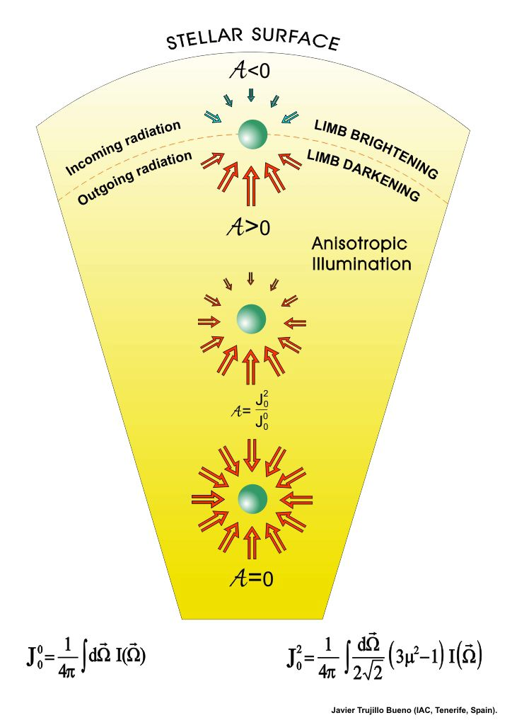
The main ingredient

Slide 30

How to quantify the radiation field properties
Like the atomic part, the radiation field is described by its associated
irreducible tensor components

Slide 31


The most relevant components of the radiation field
The mean intensity
The anisotropy
The orientation

Slide 32



Anisotropy
The geometric factor defines when the
anisotropy is positive or negative
When the radiation along the radial is more
important than the tangential one, the
anisotropy is positive. It is negative in the
opposite case

Slide 33
How to compute this in an atom?
Statistical equilibrium equations for the irreducible tensor components

Slide 34

Hanle Effect – Simple two-level atom
u
T_{E}
T_{S}
T_{A}
R_{A}
R_{E}
R_{S}
l
We assume, for simplicity, J_{l}=0 →
The trace equation (conservation of population) gives

Slide 35

The non-magnetic case
The SEE can be solved analytically and get
Mean intensity modifies the total population
Anisotropy directly generates atomic alignment in the atom

Slide 36


The magnetic case
The SEE can be solved analytically and get
The K=Q=0 terms are unchanged
The Q ≠ 0 (for K>0) terms are dephased and reduced with respect to the non-magnetic case

Slide 37
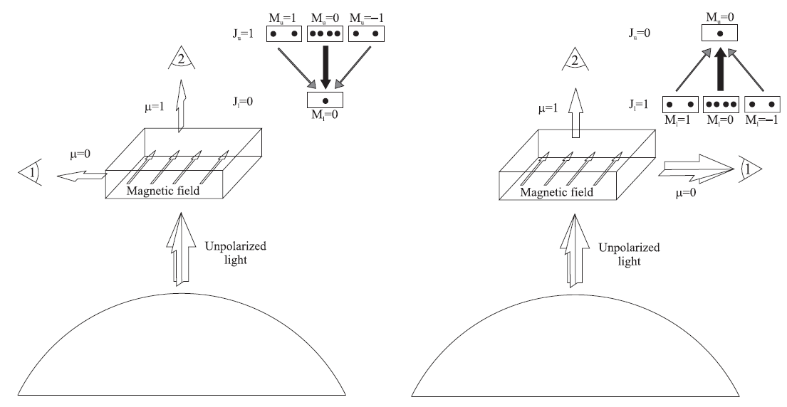
Schematics
Scattering polarization + Hanle effect

Slide 38
This is all too complex. I need some help!
The equations you need to solve are very complex, although it is
essentially just angular momentum algebra (which is mathematically
complex but conceptually simple)

Slide 39
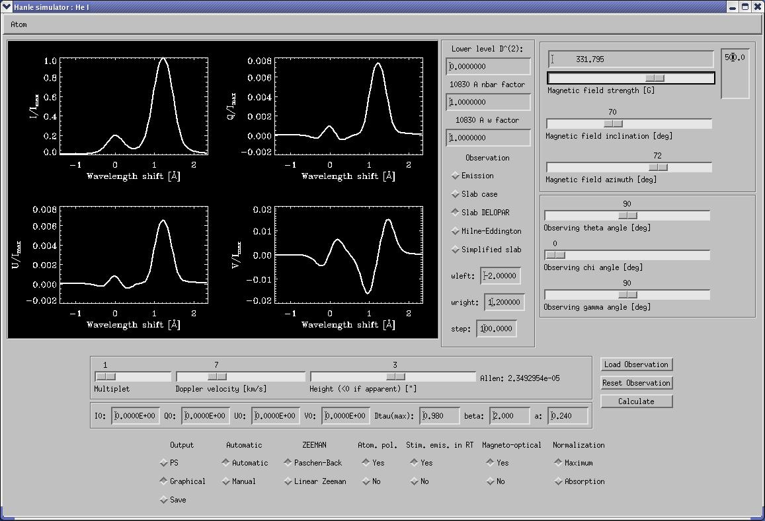
Here comes the help - Hanle Zeeman Light (HAZEL)
http://goo.gl/dj2ob
Asensio Ramos et al. (2008)

Slide 40
The atomic model for He I
3p³P
3d³D
3s³S
7065 Å
5876 Å
2p³P
3889 Å
10830 Å
2s³S
The solution to the problem requires to find the self-consistent radiation
field and its polarization and the excitation and polarization state of the
atomic system under consideration

Slide 41
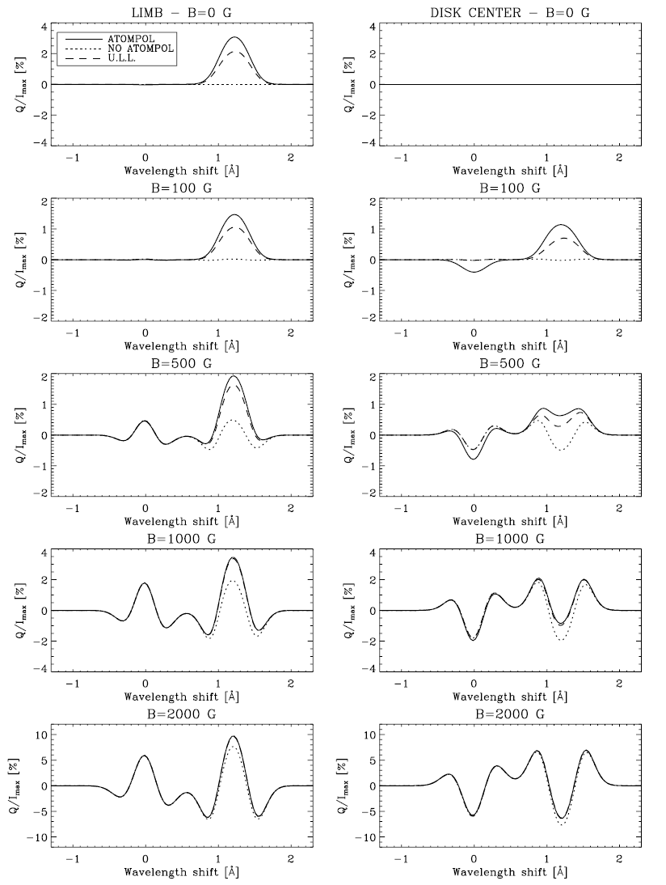
Things you can do with Hazel
DISK
CENTER
LIMB
Zeeman effect
Scattering polarization
Hanle effect
Incomplete Paschen-Back
Optically quasi-thin limit
Trujillo Bueno &
Asensio Ramos (2007)

Slide 42
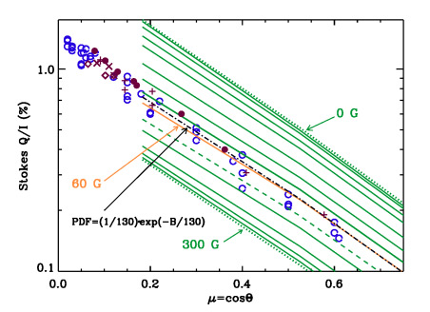
Is the Hanle effect just a curiosity?
Measure the average magnetization of the solar atmosphere
Trujillo Bueno et al. (2004)

Slide 43
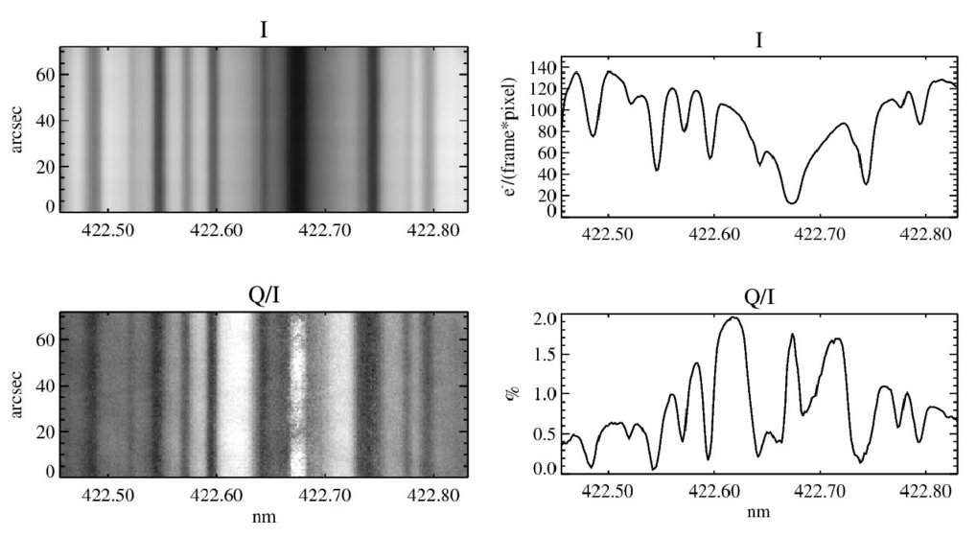
Is the Hanle effect just a curiosity?
The Ca I line at 422.7 nm in linear polarization on the limb

Slide 44
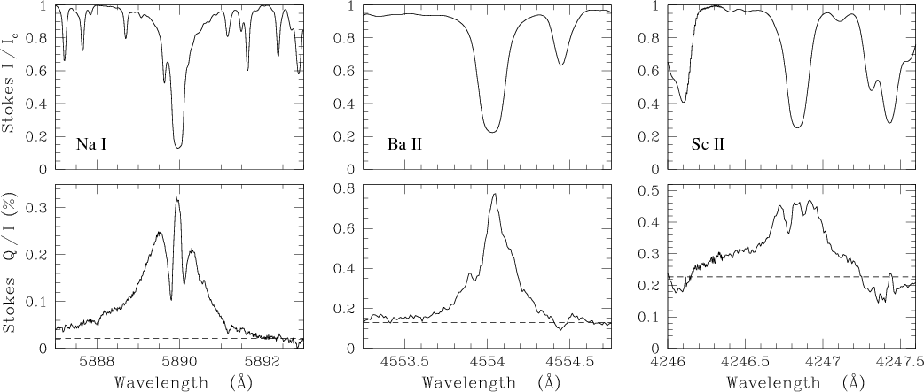
Observations
The 2nd solar spectrum is completely different from
the 1st solar spectrum
Belluzzi (2009)

Slide 45
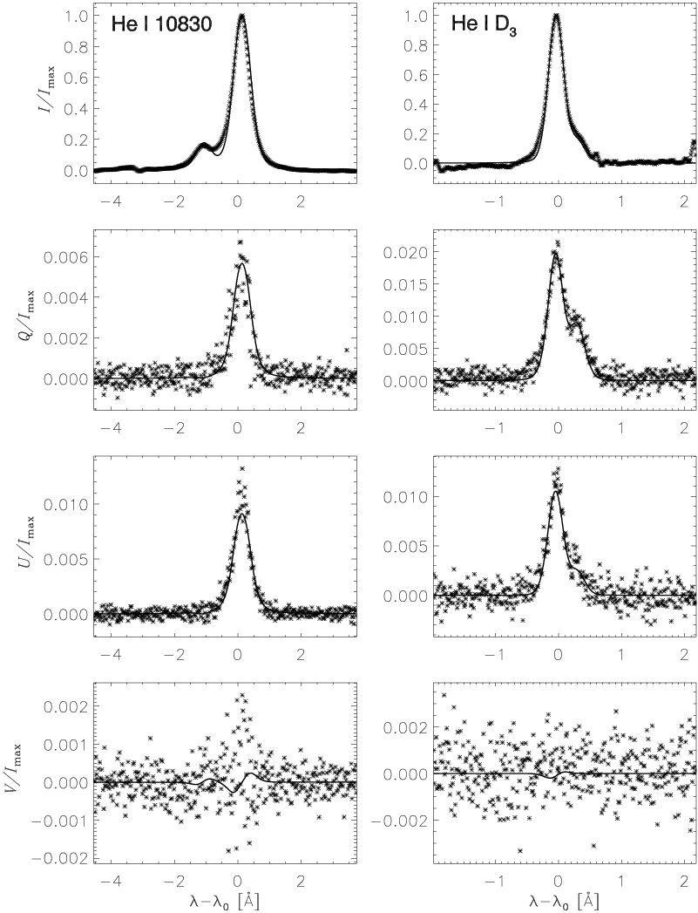
Observations
Observation of He I lines simultaneously
Casini et al. 2009

Slide 46
Inversion procedure (Hazel)
Radiation field
Radiation field anisotropy
B, , v_{th}, v_{mac}, a
Solve SEE
equations
Solve RT equation
Emergent profiles
Observed
Stokes profiles
Statistical estimator (²)
NO
² smaller than
previous?
NO
Convergence?
Propose another
set of parameters
YES
YES
Save parameters
EXIT

Slide 47
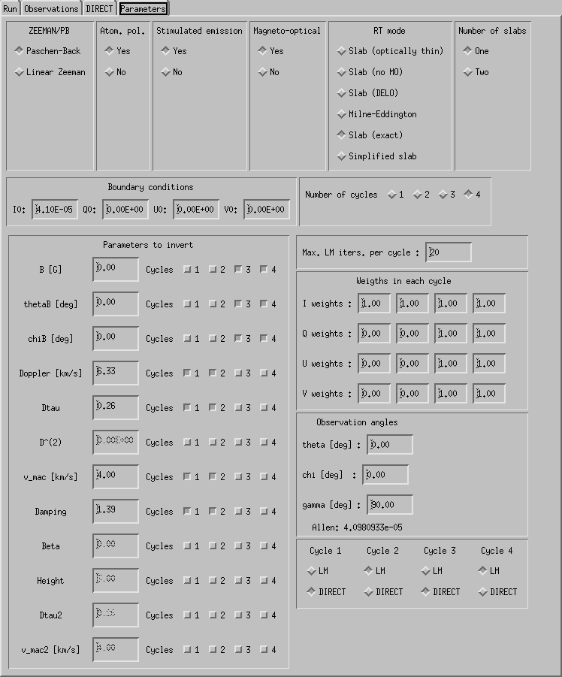
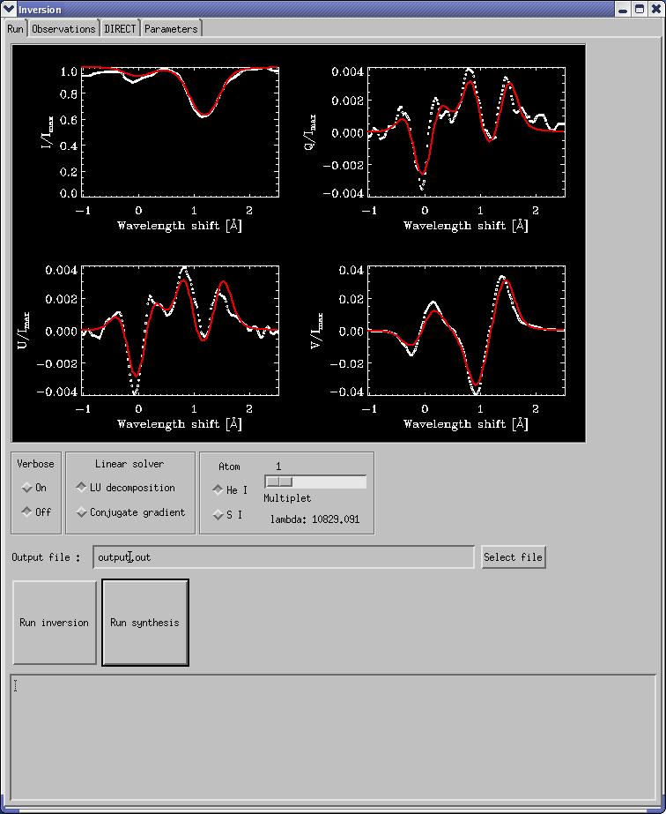
Hazel - Stokes inversion option
https://github.com/aasensio/hazel

Slide 48
The m.f. in the chromosphere is smoother than in the photosphere
Chromosphere
Photosphere
Asensio Ramos & Trujillo Bueno (2010)

Slide 49
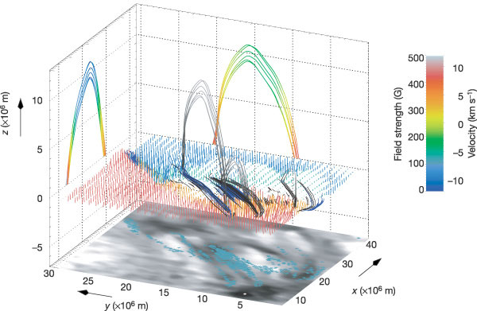
3D topology of magnetic field reconstructed from observations
Solanki et al. (2003)

Slide 50
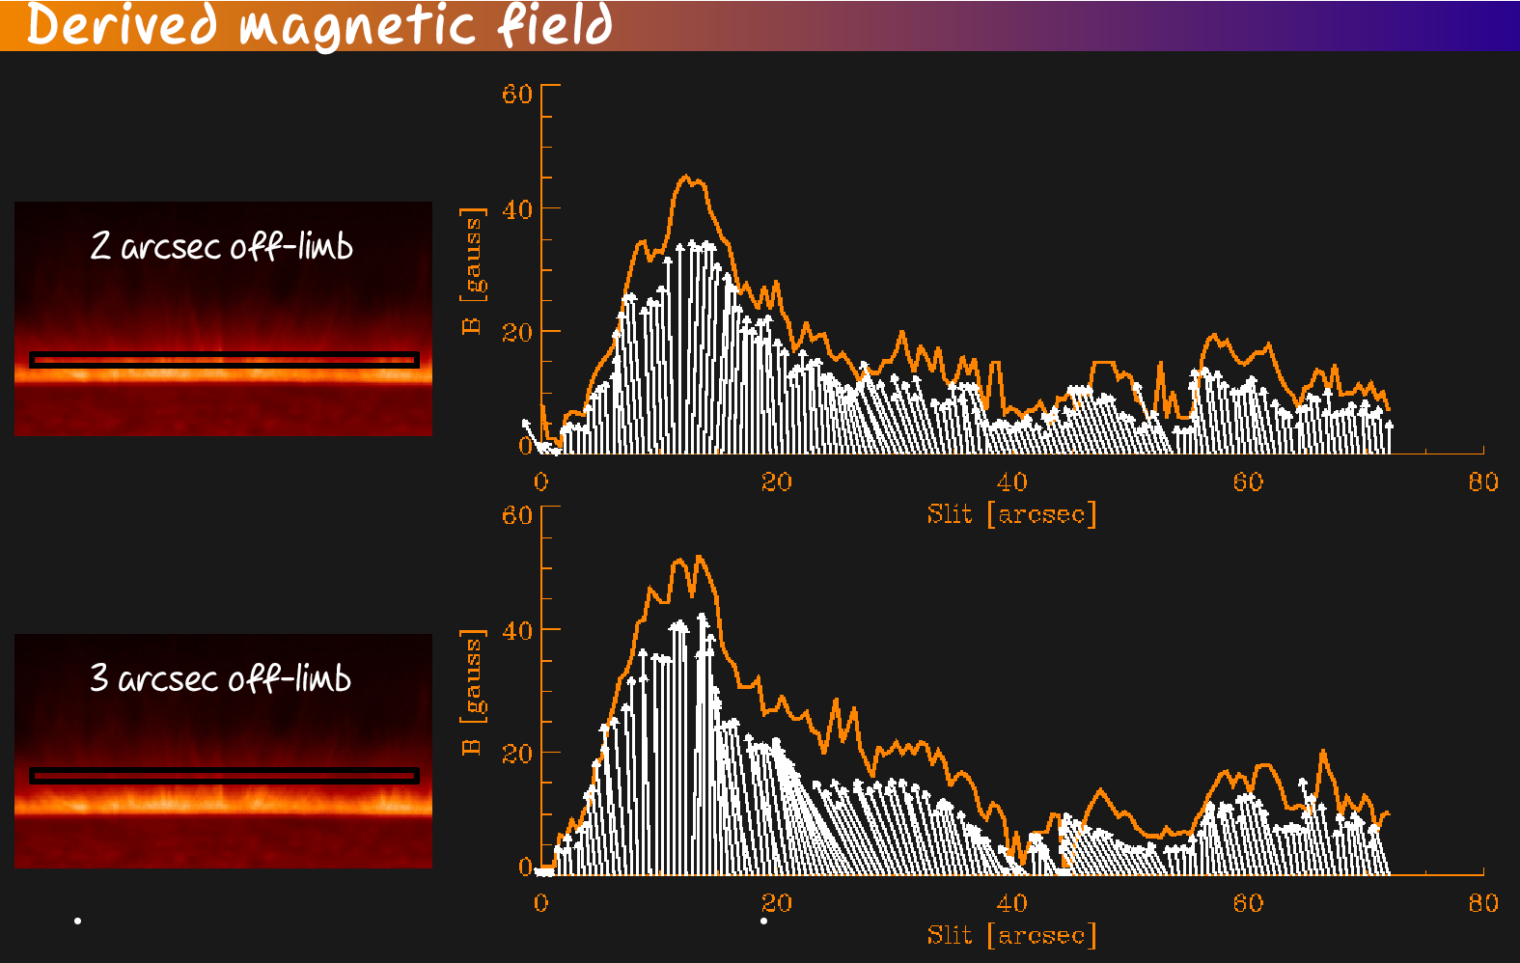
Magnetic field in spicules change with position
Centeno, Trujillo Bueno & Asensio Ramos (2010)

Slide 51
Strange guys are always around
Signatures of
atomic orientation
Martínez González, Asensio Ramos, Manso Sainz, Belluzzi & Beck (2012)

Slide 52
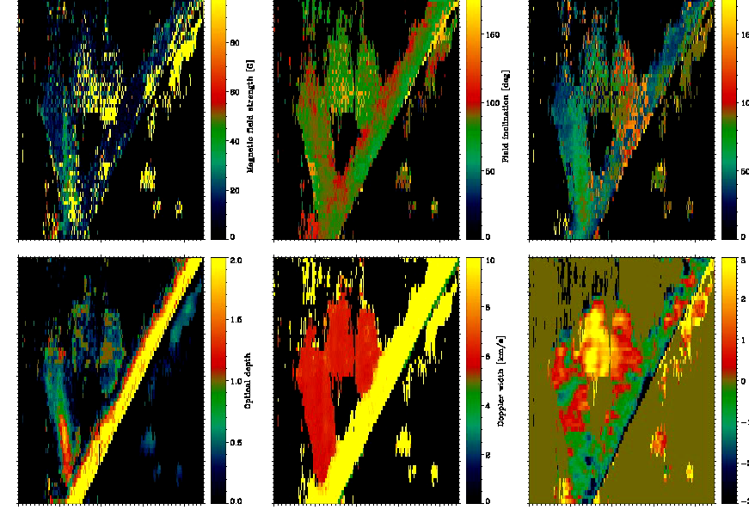
Physical properties in prominences – Four snapshots
TIP observations+PHazel inversions
Martínez González et al. (2015)

Slide 53
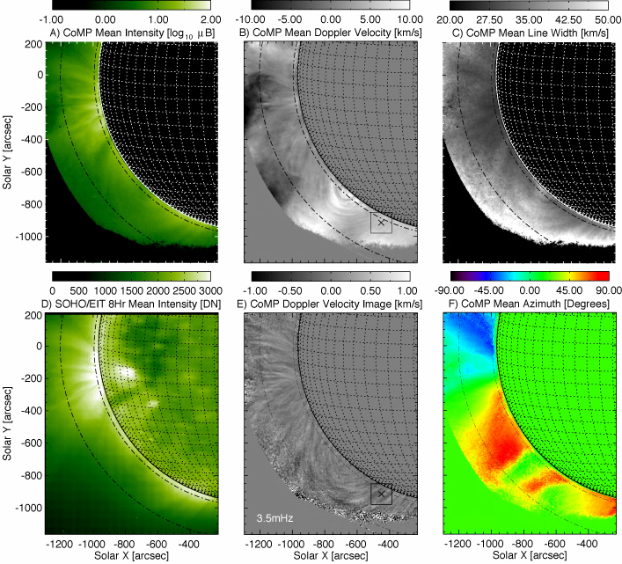
Hanle effect in coronal lines
Tomczyk (2004)

Slide 54
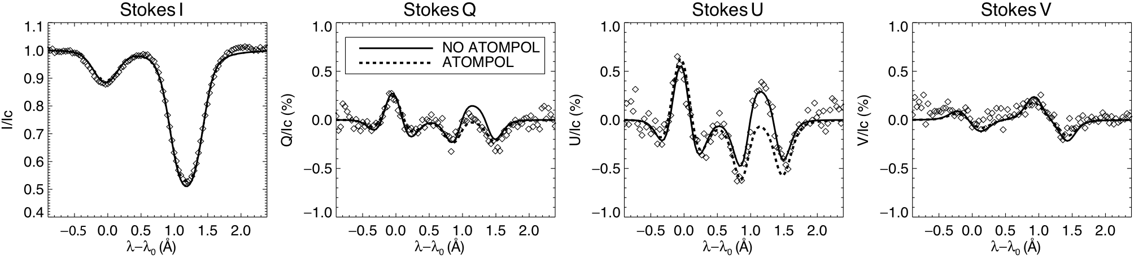
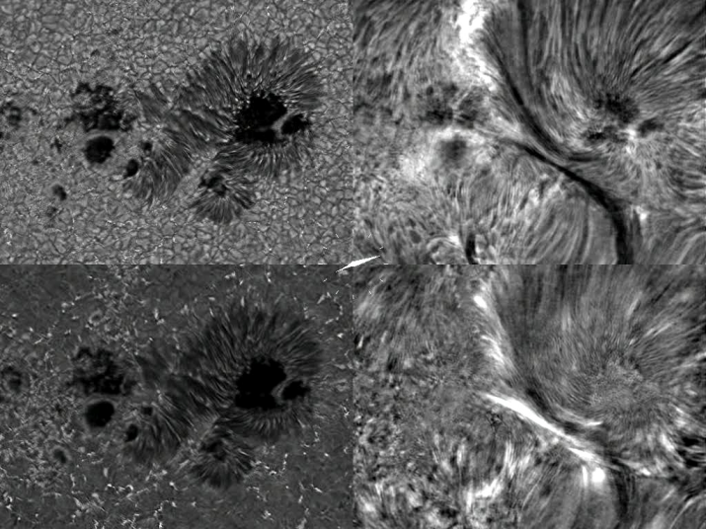
Hazel inversions (filaments)
B = 750 G
θ=97º
Strong fields with
no signature of
atomic polarization

